Slide 1
Chrono Split
A videogame by the Chrono Team

Slide 2

Contents
Introduction and Purpose
Requirements Glossary
User Reqs.
System Reqs.
Prototype Demo
Non-Functional Requirements

Slide 3


Introduction
Our game is based on the brain-child of one of our developers (Darrin) who has been working on it for some time.
Chrono-Split is a 2-D arcade-style side-scroller game.
Speed-running will be a key component.
Clearing levels quickly will earn a greater amount of points than destroying enemies.
However, the levels will increase in difficulty, which can be reduced by killing enemies and leveling up.
Ease vs. Speed

Slide 4
Requirements Glossary
Nav Mesh: An AI controller object used to navigate levels and "receive" stimuli.
Box Tracing: Used to determine items in the path of some object, as well as the traits of those said objects.
Speed Run: A play-through of a game done as fast as possible through optimizing paths and use of glitches to skip branches. Normally competitive
Skins: Aesthetic add-ons for games that are cosmetic in nature, can be thematic or simply re-colors.
Buffs/De-Buffs: abilities or effects that increase(Buffs) or decrease(De-Buffs) the stats of characters in the game.
Farming: The act of repeatedly killing enemies to earn gold, experience, and items.

Slide 5
Requirements Glossary (cont.)
Multiplayer: A game mode where players can play with or against other human controlled characters.
Hit-box: An area of a character model that can be damaged and register stimuli.
Skill-Floor: The lowest possible level skill needed to play a game with success.
Skill-Ceiling: The highest possible skill needed to play a game successfully.
Crowd-Control: An ability that hinders the movement of characters in the game.
Game Mechanics: The basic functions and constraints that determine the way the game plays and how the player and environment interact.

Slide 6
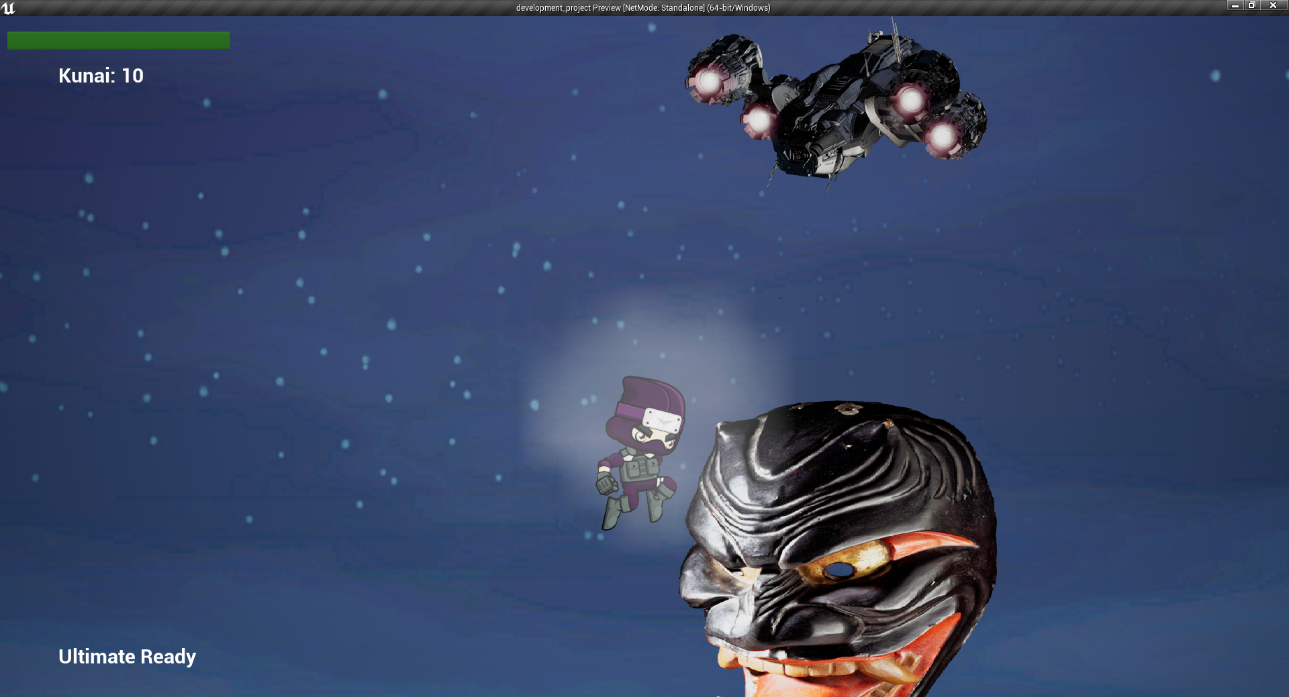
User Reqs.
The User needs to be able to do several things within the game.
On Start they should be able to select at least one of three characters
Upon selecting that character they need to be able to use skills and move the character.
The player should also be able to access a skill tree and purchase and upgrade skills.
Gameplay constraints include having to buy preceding skills before buying the next skill, users will need to deal with limited items and cooldowns for skills.
Upon player death, the user should be able to select a different character or continue with the previous.

Slide 7


System Reqs.
Basic Requirements to run the game
Windows 7/10 OS or MacOS equivalent
32 or 64-bit processor
2GB of RAM
1GB Storage Space
No special Graphics Card requirements (onboard/discrete)
Hardware Peripherals Required
Mouse/Keyboard (Gamepad may be used)

Slide 8
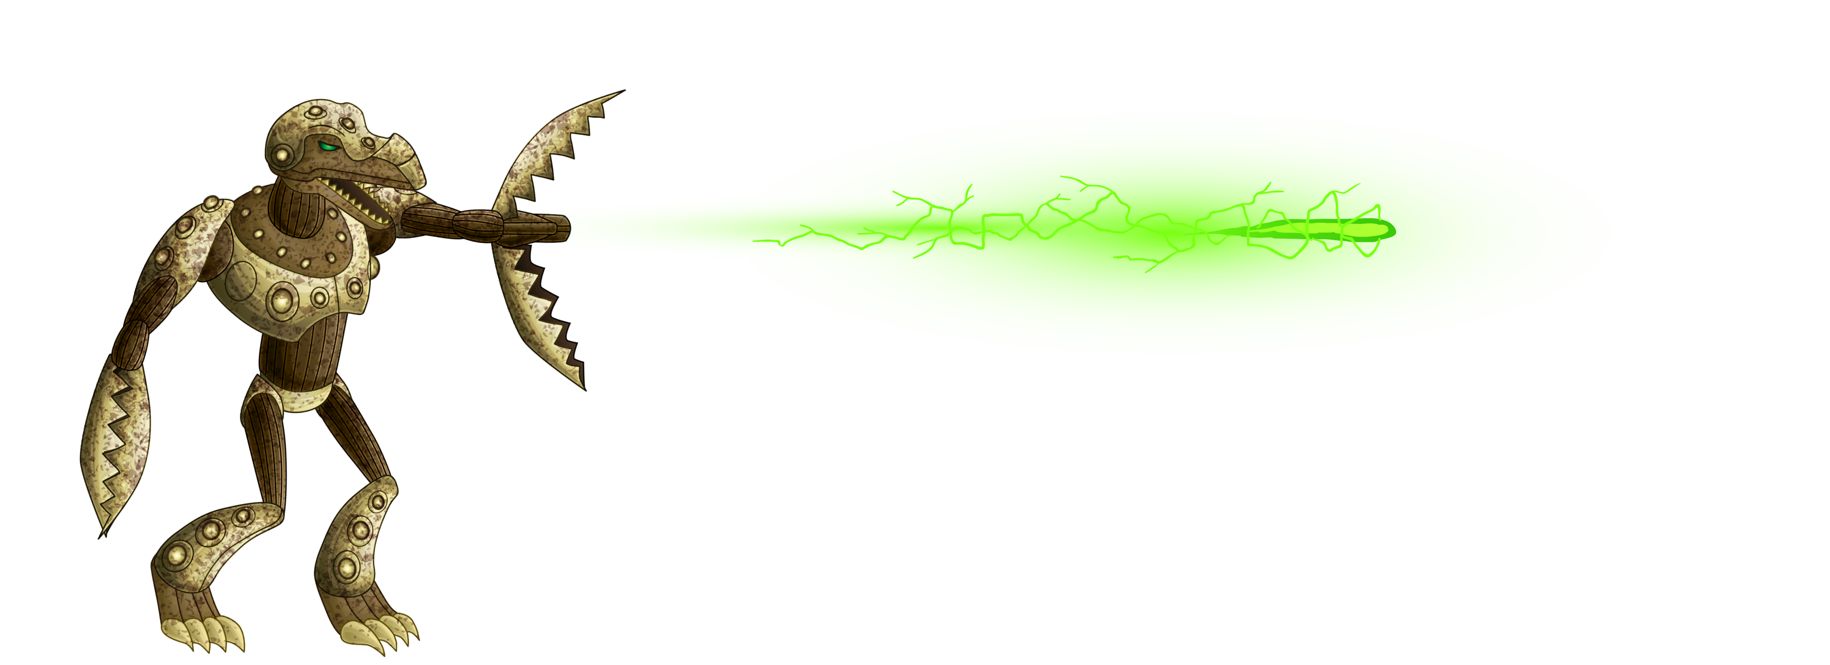


Prototype
Demo Video!!!

Slide 9



Non-Functional Reqs.
The system needs to have several non-functional requirements to be considered playable and functional.
System must be resource-efficient to run on numerous environments
Controls must be highly responsive (no lag).
Game should take about no longer than an hour to play through at the slowest in order to minimize chance of seizure in epileptics.
No security requirements are needed since it is not multiplayer, nor does it store sensitive information regarding the player.
Hit-boxes and time-tracking being accurate and intuitive are imperative to the feel of the game.

Slide 10
Disclaimer
The graphical assets that are used in this game are obtained from open source platforms with commercial or personal use licenses.
Links to the assets are provided in the SRS document.

